Slide 1
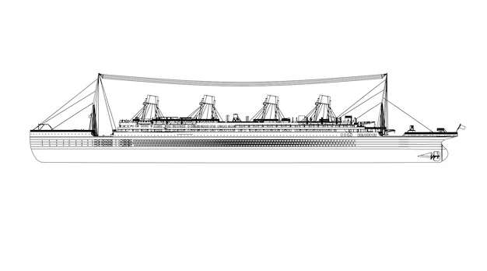

Extensive Titanic Analysis Project
Analysed using python (pandas, numpy, seaborn, matplotlib)
by Eryk Suchan
Data Source:
https://www.kaggle.com/competitions/titanic/overview

Slide 2
Outline
Introduction
Data Sources
Documentation of cleaning and manipulation
Summary of Data Analysis
Key Visualisations and Findings
Summary

Slide 3
Introduction
My name is Eryk and I am responsible for creating the following analysis. For over a year, I have been studying python, sql, excel, powerbi. My main focus is to develop my skills in numpy,pandas, matplotlib, seaborn. Those skills will be visible within this analysis presentation. The precision for detail is key for me, so if any mistakes have been made, please let me know! I appreciate every piece of help.
The chosen dataset for this analysis is ‘Titanic - Machine Learning from Disaster’. My main focus was on achieving more than in the previous project which I did. Spending a major amount of time on analysing each piece of information and doing appropriate research has helped me to use dedicated python libraries to create this project.
Personal Task: To analyse the given dataset and find out a variety of different potential outcomes that occurred during the Titanic wreck. My goal is to push my current skills to a different level
Problem: The data within the csv file isn’t clearly readable for the majority. My job is to implement different graphs to present the data within the table.

Slide 4

Data Source Used
The data source has been used from kaggle via Public Domain. The dataset is part of a competition in which users can submit their research and share it with other users. Below is a short project description: In this challenge, we ask you to build a predictive model that answers the question: “what sorts of people were more likely to survive?” using passenger data (ie name, age, gender, socio-economic class, etc).
This data is deemed credible as it operated under a public domain with data made available.

Slide 5

Documentation of cleaning & manipulation

Slide 6

The following step was to run the top 5 rows to check if the data is shown accurately. Afterwards, I have renamed title of rows which are more difficult to understand.
The dataset was downloaded and stored with an appropriate file name
Installation of libraries used was made. Libraries such as Pandas, Numpy, Matplotlib and Seaborn were used in this project.
Lastly, checks were made to check were the empty values are employed. Duplicates were also checked, if any, they were deleted.

Slide 7
Summary Continued…
Summary analysis was carried out on the dataset and the following statistics were taken:
Heatmap of missing values.
Total male and female amount on the ship in percentage.
Amount of women and men that survived and didn’t survive - percentage and number amount.
Percentage of children comparing to adults on the ship.
Survivors split appropriately into groups to showcase the group survival rate.
Percentage and amount way to showcase survivals per class ( 1st, 2nd, 3rd).
Split graph showing total amount of people per class and how many died.
Age vs fare by survival status ( ages of individuals in each class and their survival rate).
Total amount of people that embarked and the amount that survived.
Amount of people with different number of siblings ( non-survivals vs total amount).
Age distribution by gender.
Age distribution by class.
Showcase of different age groups and if their survival rate.
Sum of passengers showcasing the amount of parents/ children they have.

Slide 8

Key Findings

Slide 9
Key Findings
From the dataset I have gathered that on the titanic, there were 64.8% of men and 35.2% of females.
The survival rate of women is much higher, standing at 74% whereas men is only 18%!
On the ship, 15.8% of people were children and the following were adults at different age gaps.
People in first class had the biggest possibility of survival, standing around 62% whereas in third class it was only 24%!
55% of people were booked in the third class, 20.8% in second class and 24.2% in first class.
644 individuals embarked on Southampton station.

Slide 10
Key findings 2
The passengers that embarked on Southampton station, had the biggest amount of losses between the three stations.
Over 600 people on the ship didn’t have any siblings.
Surprisingly, the individuals that had 4 or more siblings, had the lowest death rate.
On average, the male passengers were older than the average female passengers.
The first class group had the oldest age group average, standing around an average age of 38.
No teens between the age of 13-17 had lost their life during the wreck.
Like with siblings, most people on the ship standing around 650 didn’t have a parent on board.

Slide 11

Key Visualisations
Visuals from the datasets and analysis

Slide 12
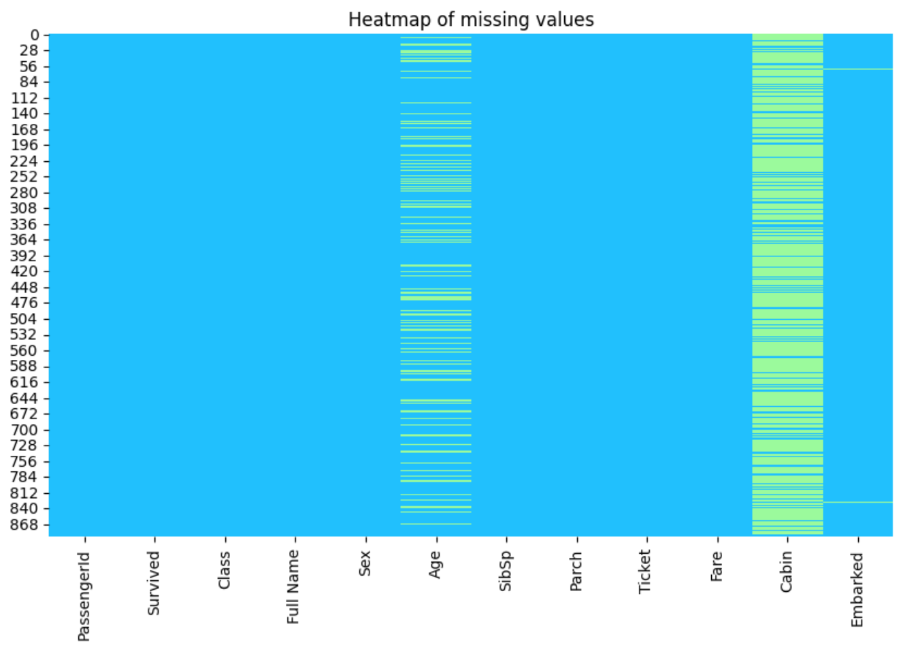
Chart 1: Heatmap of missing values
The first step in my titanic project was to load in the data and find out where are the most missing values - in what columns. From what I have found out, the most missing values are in the age and cabin. This may be due to the fact that the specific age wasn’t initially specified when buying the tickets. The cabin missing data values suggest that there was a mix up and data loss on who is in what cabin.

Slide 13
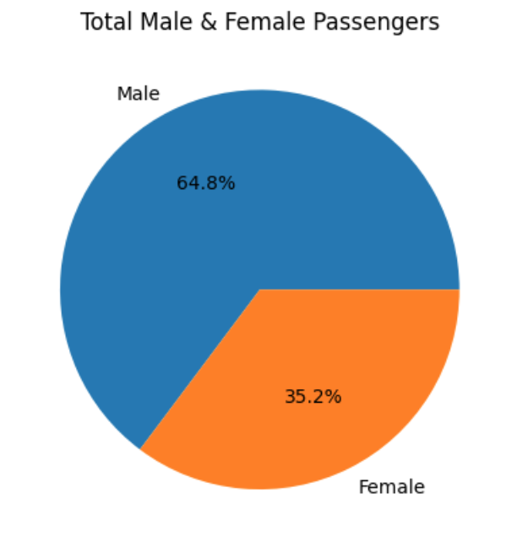
Chart 2: Total Male and Female Passengers
The pie chart shows the amount of males and females in percentages that were onboard. Clearly the number favours more towards the male side, suggesting that much more males were on board the titanic on the day of the ship wreck.

Slide 14
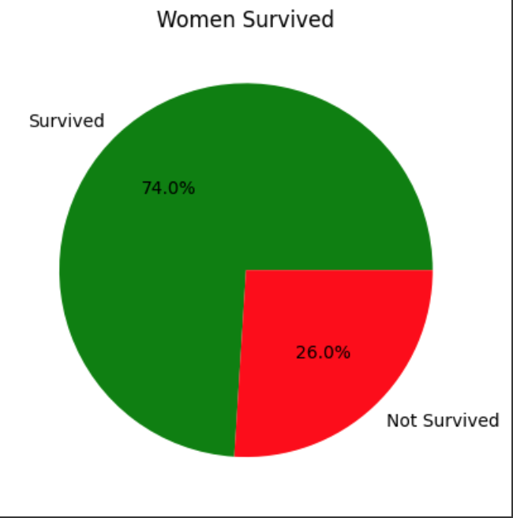
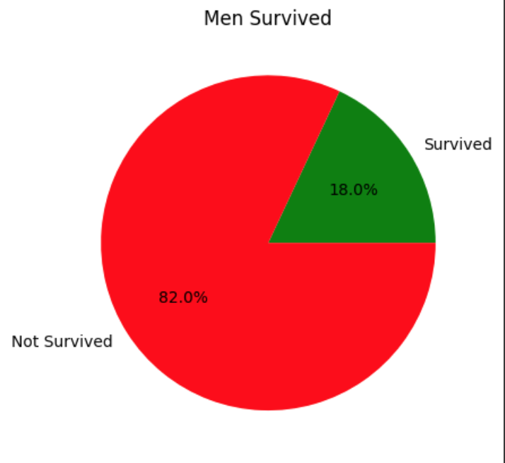
Chart 3 & 4: Men & Women Survived
Figure 1
Figure 1 & 2 show us the amount of women and men who survived in the catastrophic event. Comparing both pie charts, there is a drastic difference in the number of people who survived. 74% of women survived this event whereas only 18% of men managed to get away from the disaster.
This clearly shows that more women were put on the lifeboats and had the priority to escape from the ship.
Figure 2

Slide 15
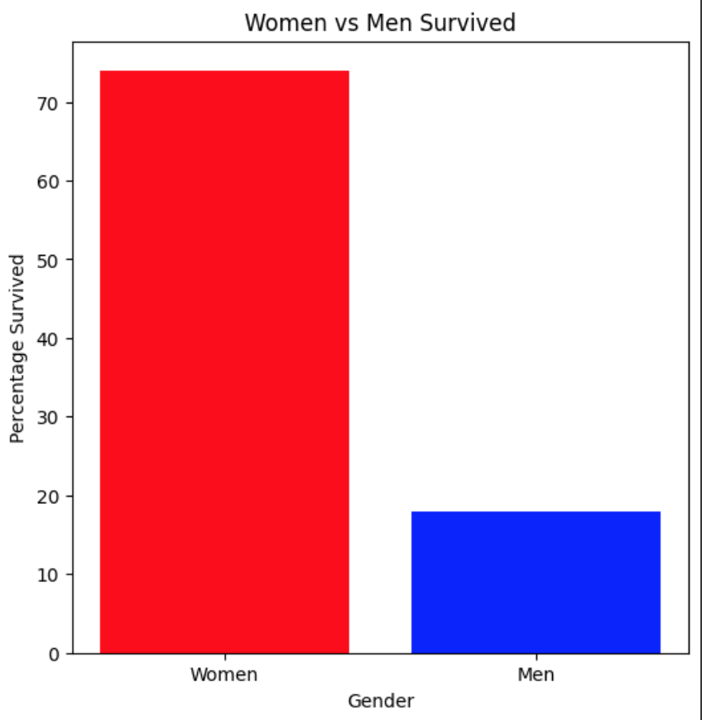
Chart 5: Women vs Men Survived v2
Moving on to the bar chart, we can clearly see the difference in the survival rate between the women and the men. Around 3 times more women were rescued compared to the men. In the future slides, I will dive deep into each age bracket.

Slide 16
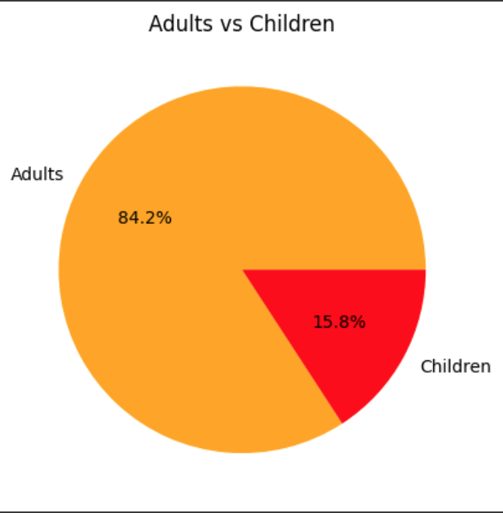
Chart 6: Adults vs Children on the Titanic
The pie chart on the right displays the amount of children and adults in percentages that were on the ship. 15.8% of children is not a majorly concerning number. In the upcoming slides, we will see how many children survived.

Slide 17
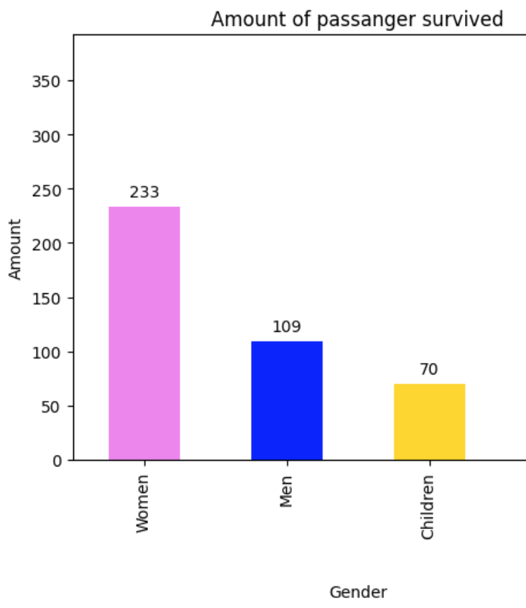
Chart 7: Amount of passengers survived.
Until now, we have only seen the percentages of survival, but now we see the actual amounts .
We can see that there is more than half females that survived, whereas the male figure has dropped drastically.

Slide 18
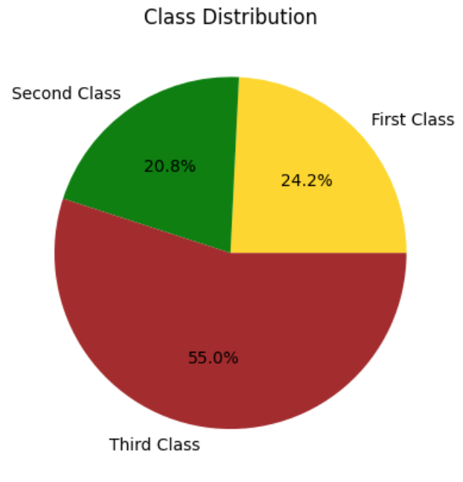
Chart 8: Percentage of Class Distribution
The pie chart on the right shows us the class distribution of passengers in each class. The third class has more passangers that first and second class combined.
This does make sense because the tickets on the titanic were not cheap and most people could not afford to treat themselves to a higher standard ticket.

Slide 19
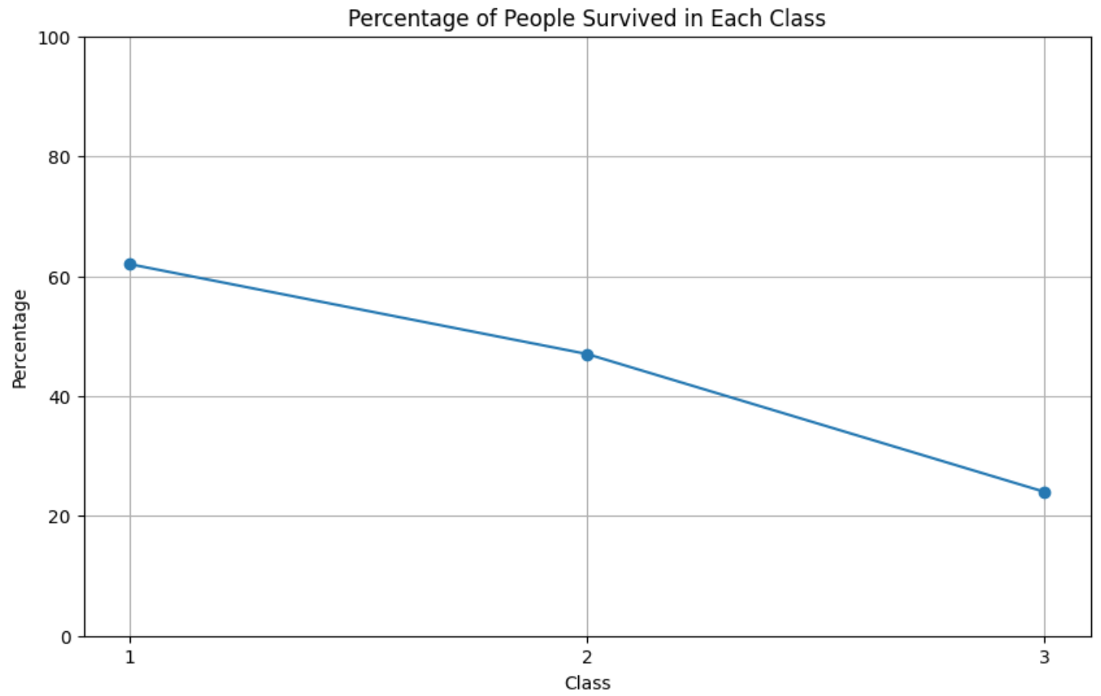
Chart 9: Percentage of survival per class
Moving on, the amount of people that survived in first class is over 60% whereas comparing it to third class, over 20% of individuals only survived. This suggests that the first class had a major priority in leaving the ship once the crash happened.

Slide 20
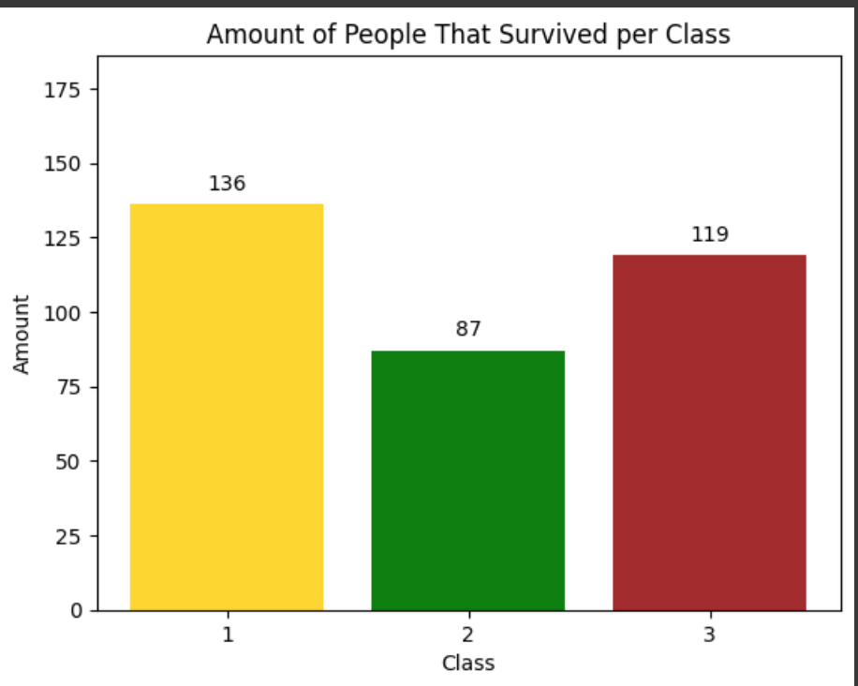
Chart 10: Amount of people that survived per class
The bar graph on the right shows the amount of people that survived per class. The second class had originally the least amount of passangers, and after looking at the graph on the right, we can still determine this factor.

Slide 21
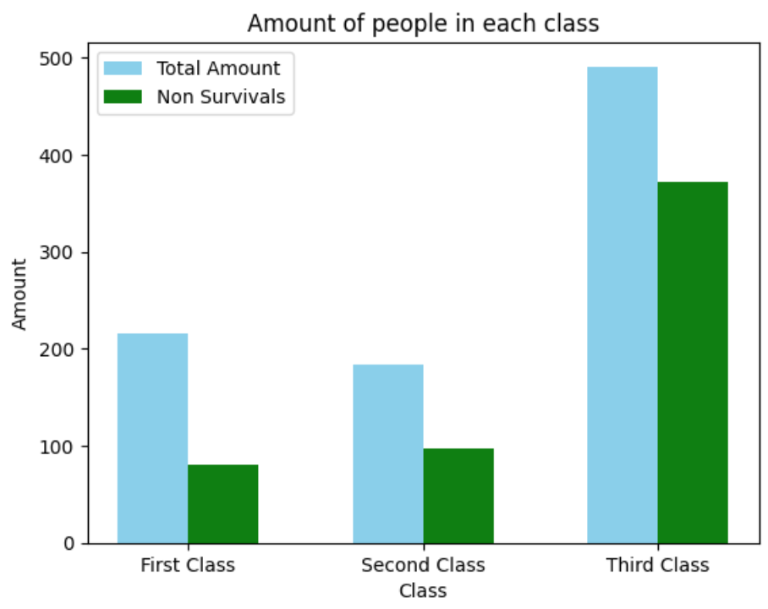
Chart 11: Comparison of people in each class
To showcase the survival rate more clearly, I have created a side by side comparison of total amount of passengers that there were originaly in sky blue and in green, the bar shows the amount of people that passed away.
The pattern is clearly shown here of the amount of people that died in third class.

Slide 22
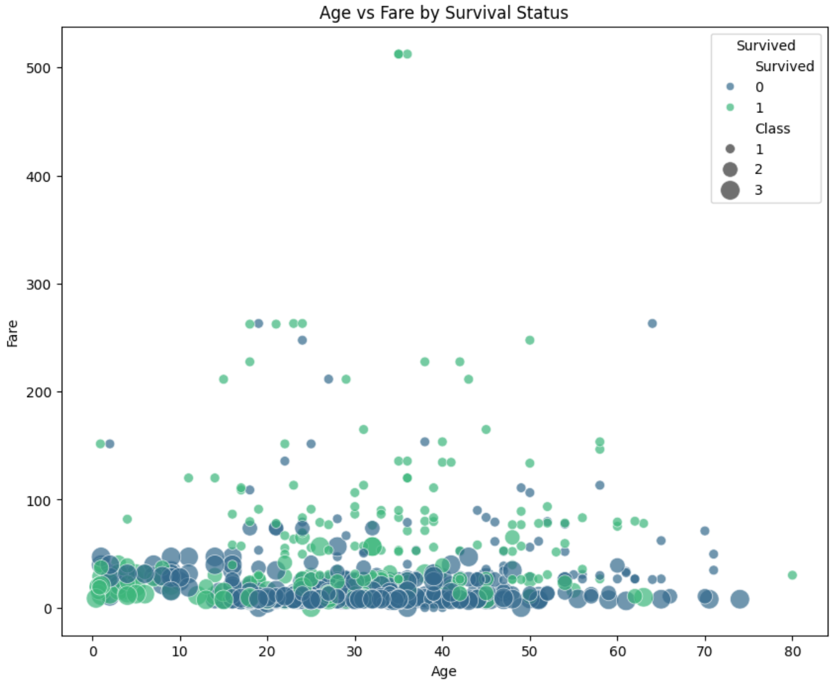
Chart 12: Age vs Fare by Survival Status
The scatterplot shows the age distribution on the x axis and the fare price ticket on the y axis. The blue dots show us each individual that didn’t survive whereas the green show us the ones who did. The size of the dots showcase the class in which each individual was in, 3rd class showing the biggest dots and first class the smallest.
We can see from the pattern that the more people paid for the fare, the more chances they had to survive.

Slide 23
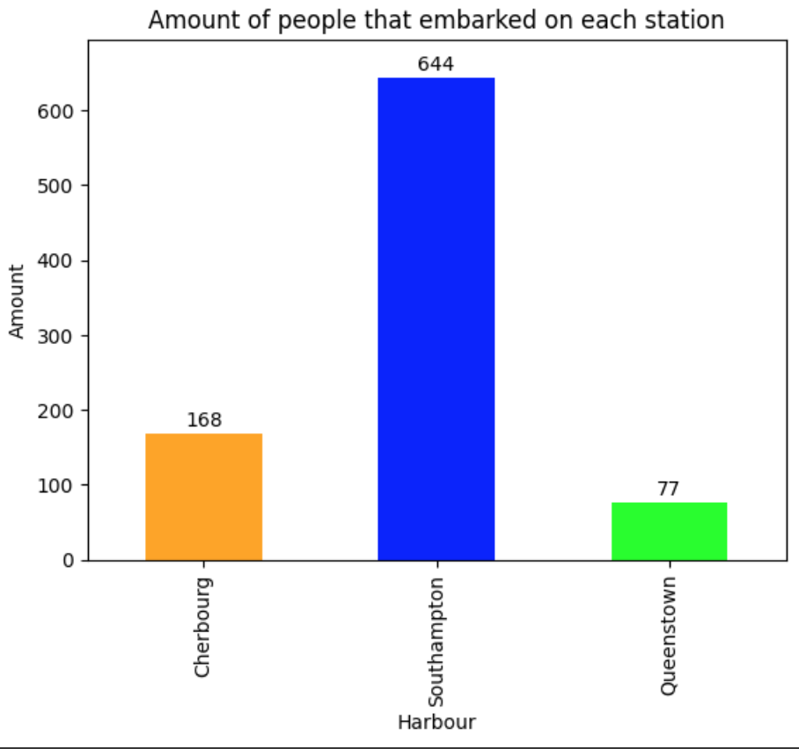
Chart 13: Number of people on each harbour
The bar graph shows the amount of people that embarked on each harbour. From the graph we can see the greatest amount is on Southampton.
In the upcoming slides, we will see how many people died on each station showcasing surprising statistics.

Slide 24
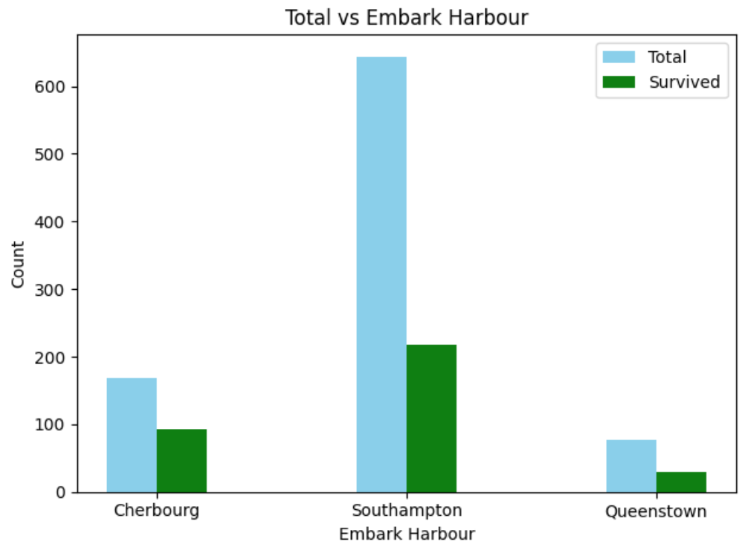
Chart 14: Total amount vs Survived on each Harbour
As mentioned in the previous slide, we can clearly see that the amount of individuals that got on the Southampton harbour had the biggest death rate.
Cherbourg and Queenstown, had on the other hand the least amount of people that died.

Slide 25
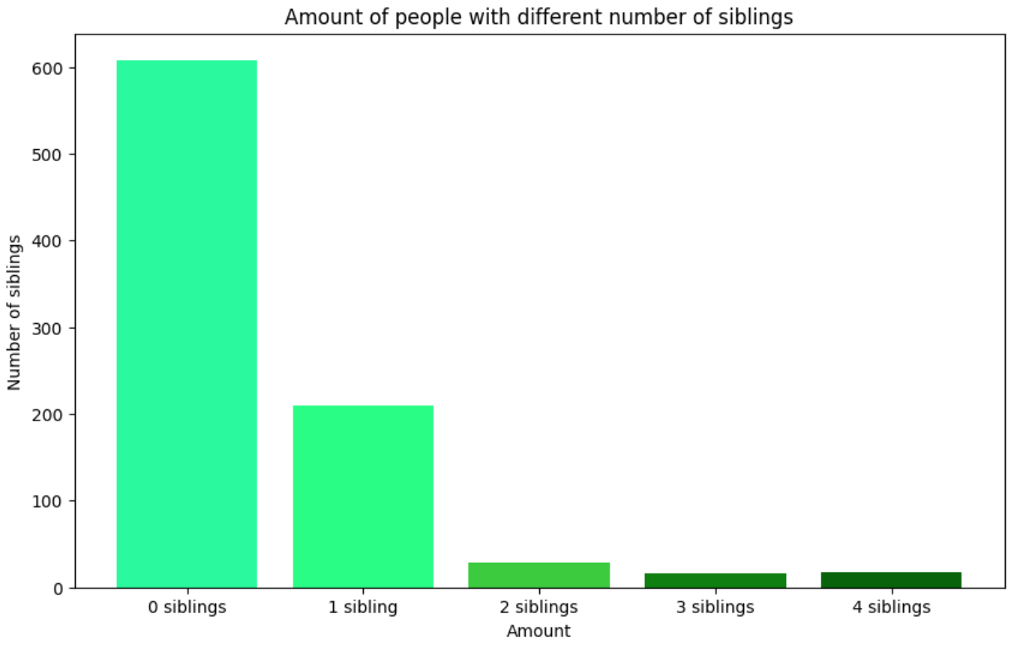
Chart 15: Amount of people on the cruise with the number of siblings
It is clearly shown that over 600 people on the ship didn’t have any siblings attached to them on the day of their embark.
There is although a big difference between 1 sibling and 2 siblings.
The remaining amounts are at a very close range. 3 siblings is tiny bit lower but nothing major.

Slide 26
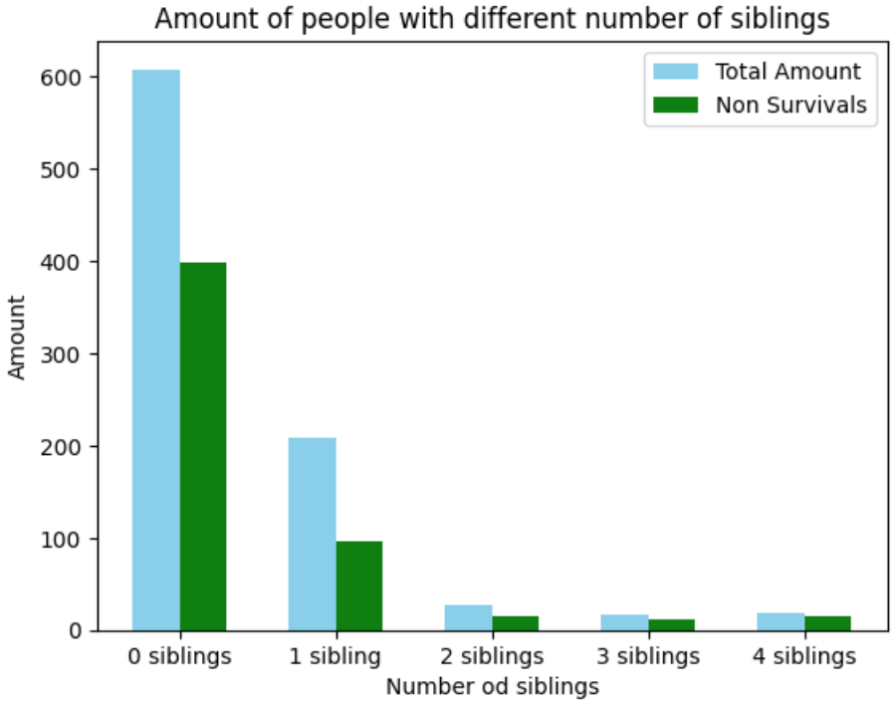
Chart 16: Total amount vs Non Survivals
The previous graph has only shown the total amount of individuals with siblings whereas here I have displayed the total amount right next to the non survivals of passengers that had siblings.
From what we can gather, the more siblings someone had, the less chances they had to survive.

Slide 27
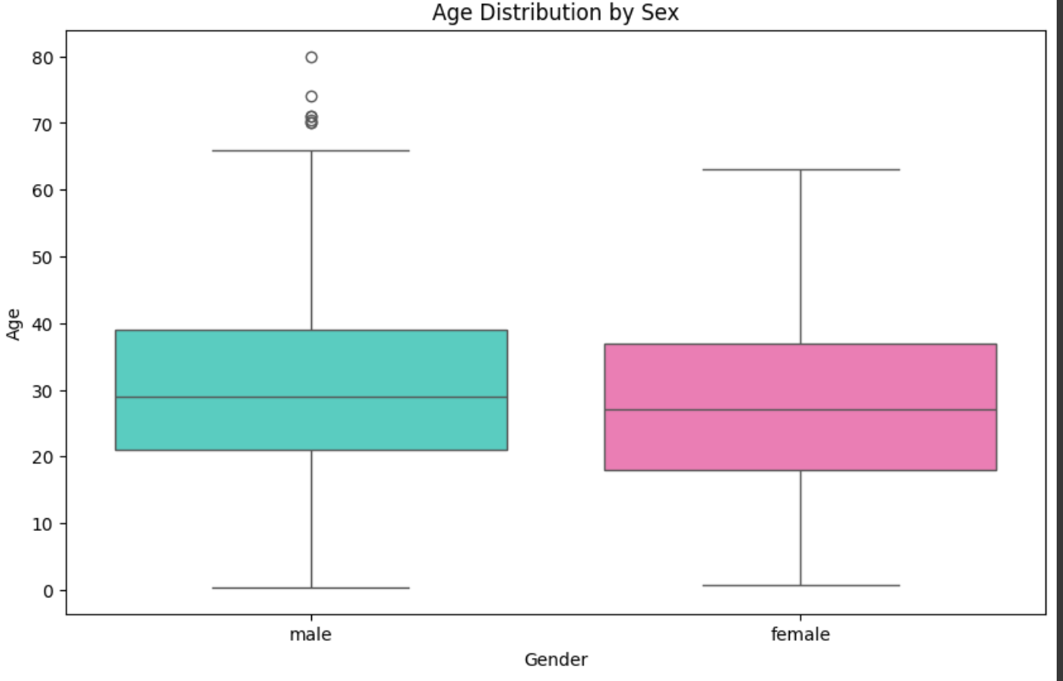
Chart 17: Age vs Gender distribution
The boxplot shows us the gender distribution of males and females that were on the ship.
We can see that the male passengers had a higher average age than the females.

Slide 28
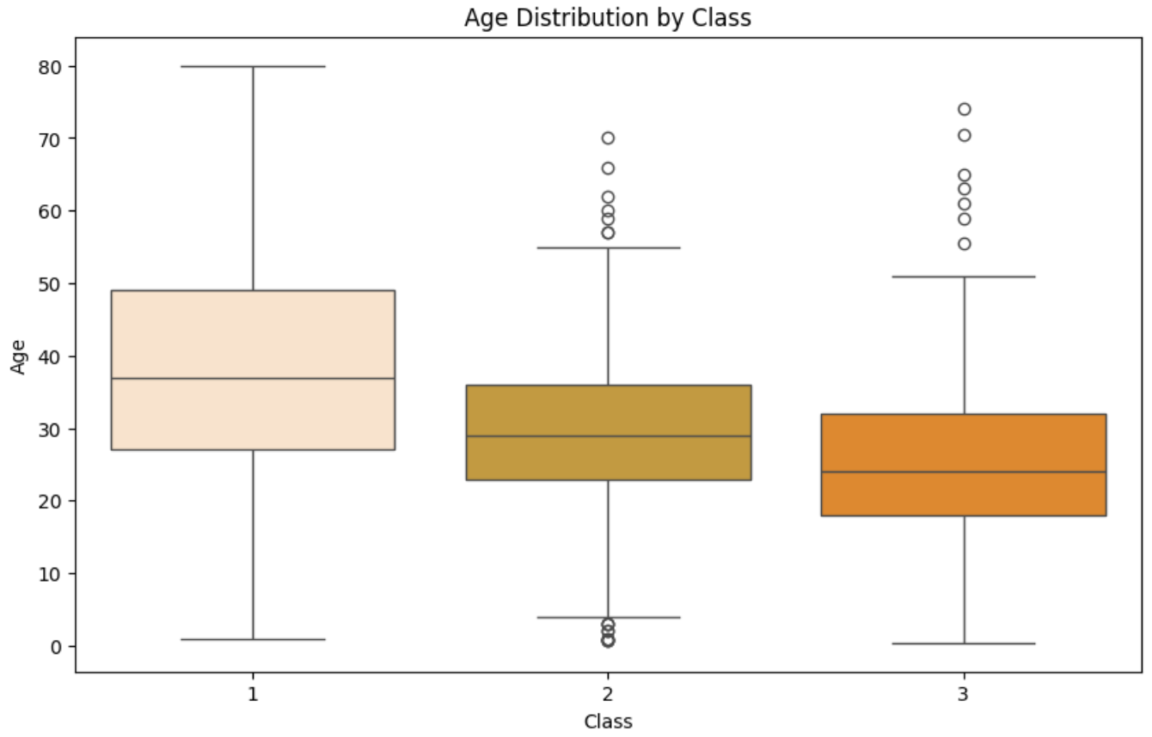
Chart 18: Age distribution by class
After finding out the average age by gender, we can now gather that the first class had the highest average age of passengers whereas the third class had the lowest.
Furthermore, the biggest age difference was in first class.

Slide 29
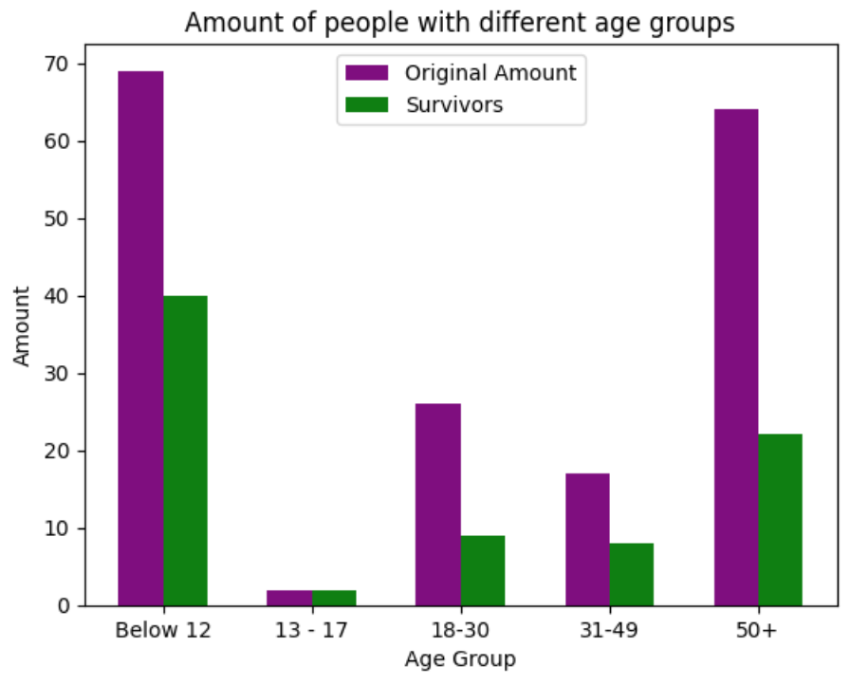
Chart 19: People vs different age groups
The bar chart which showcases a lot of information at once. We can see the different age groups and the comparison between the total amount of them and how many survived.
From the chart, it is easy to gather that the ages 13-17 had little to none casualties.
Surprisingly, the age 50+ had the most amount of people that died in the evacuation stage.

Slide 30
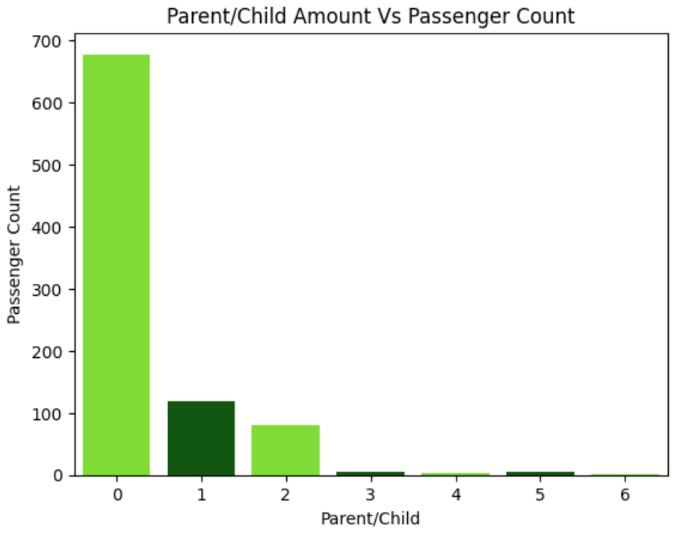
Chart 20: Parent/ Child amount vs passenger count
The pattern can easily correlate with the previous graph that we saw which was the siblings vs amount. In that graph most passengers had no siblings and the same result can be seen here. Most people didn’t have a parent or a child with them. Moreover, there wasn’t many big families larger than 2.
This suggests that most people were travelling alone.

Slide 31
Summary:
This whole research has indicated many surprising facts about the titanic disaster. The biggest surprise for me was to see the amount of people that died in third class comparing to first and second class. There was a clear pattern for priority to first class passengers. Moreover, it did surprise me that individuals above the age of 50 had the lowest survival rate, taking into consideration that the first class passengers had the highest average age.
Whilst doing the research, I have learnt to process the data using many different libraries which I haven’t been so much familiar with before. I am looking forward to my upcoming projects integrating data analysis with AI & ML.

Slide 32
Thank you for reading

